Slide 1
Chapter 1 Introduction to the design and Analysis of algorithms
Dr. Ali Alsaffar – Department of Computer Science

Slide 2
Plan
What is an Algorithm?
Fundamentals of Algorithmic Problem Solving
Important Problem Types
Sorting
Searching
String Processing
Graph Problems
Combinatorial problems
Numerical Problems
Fundamental Data Structures
Linear Data Structures
Graphs
Trees
Sets and Dictionaries

Slide 3
1. What is an Algorithm?
Definition: An algorithm is a sequence of unambiguous instructions for solving a problem, i.e., for obtaining a required output for any legitimate input in a finite amount of time.
The same algorithm can be represented in several different ways
Several algorithms for solving the same problem may exist
Those algorithms can be based on different ideas and have different speeds
Problem
The range of input has to be specified carefully
Algorithm
Input
Computer
Output

Slide 4
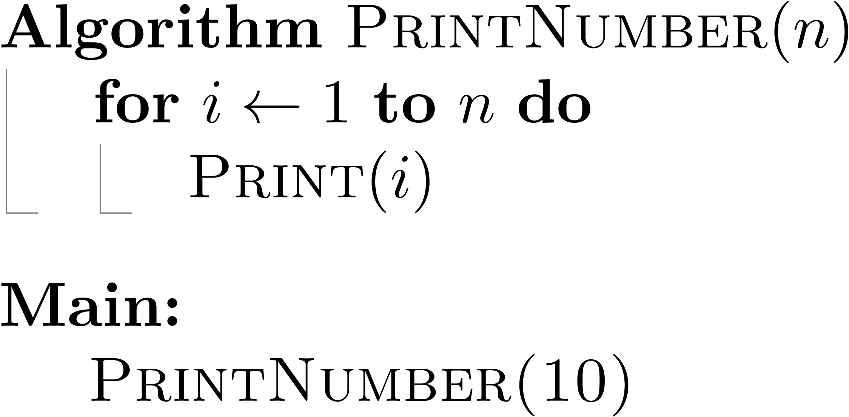
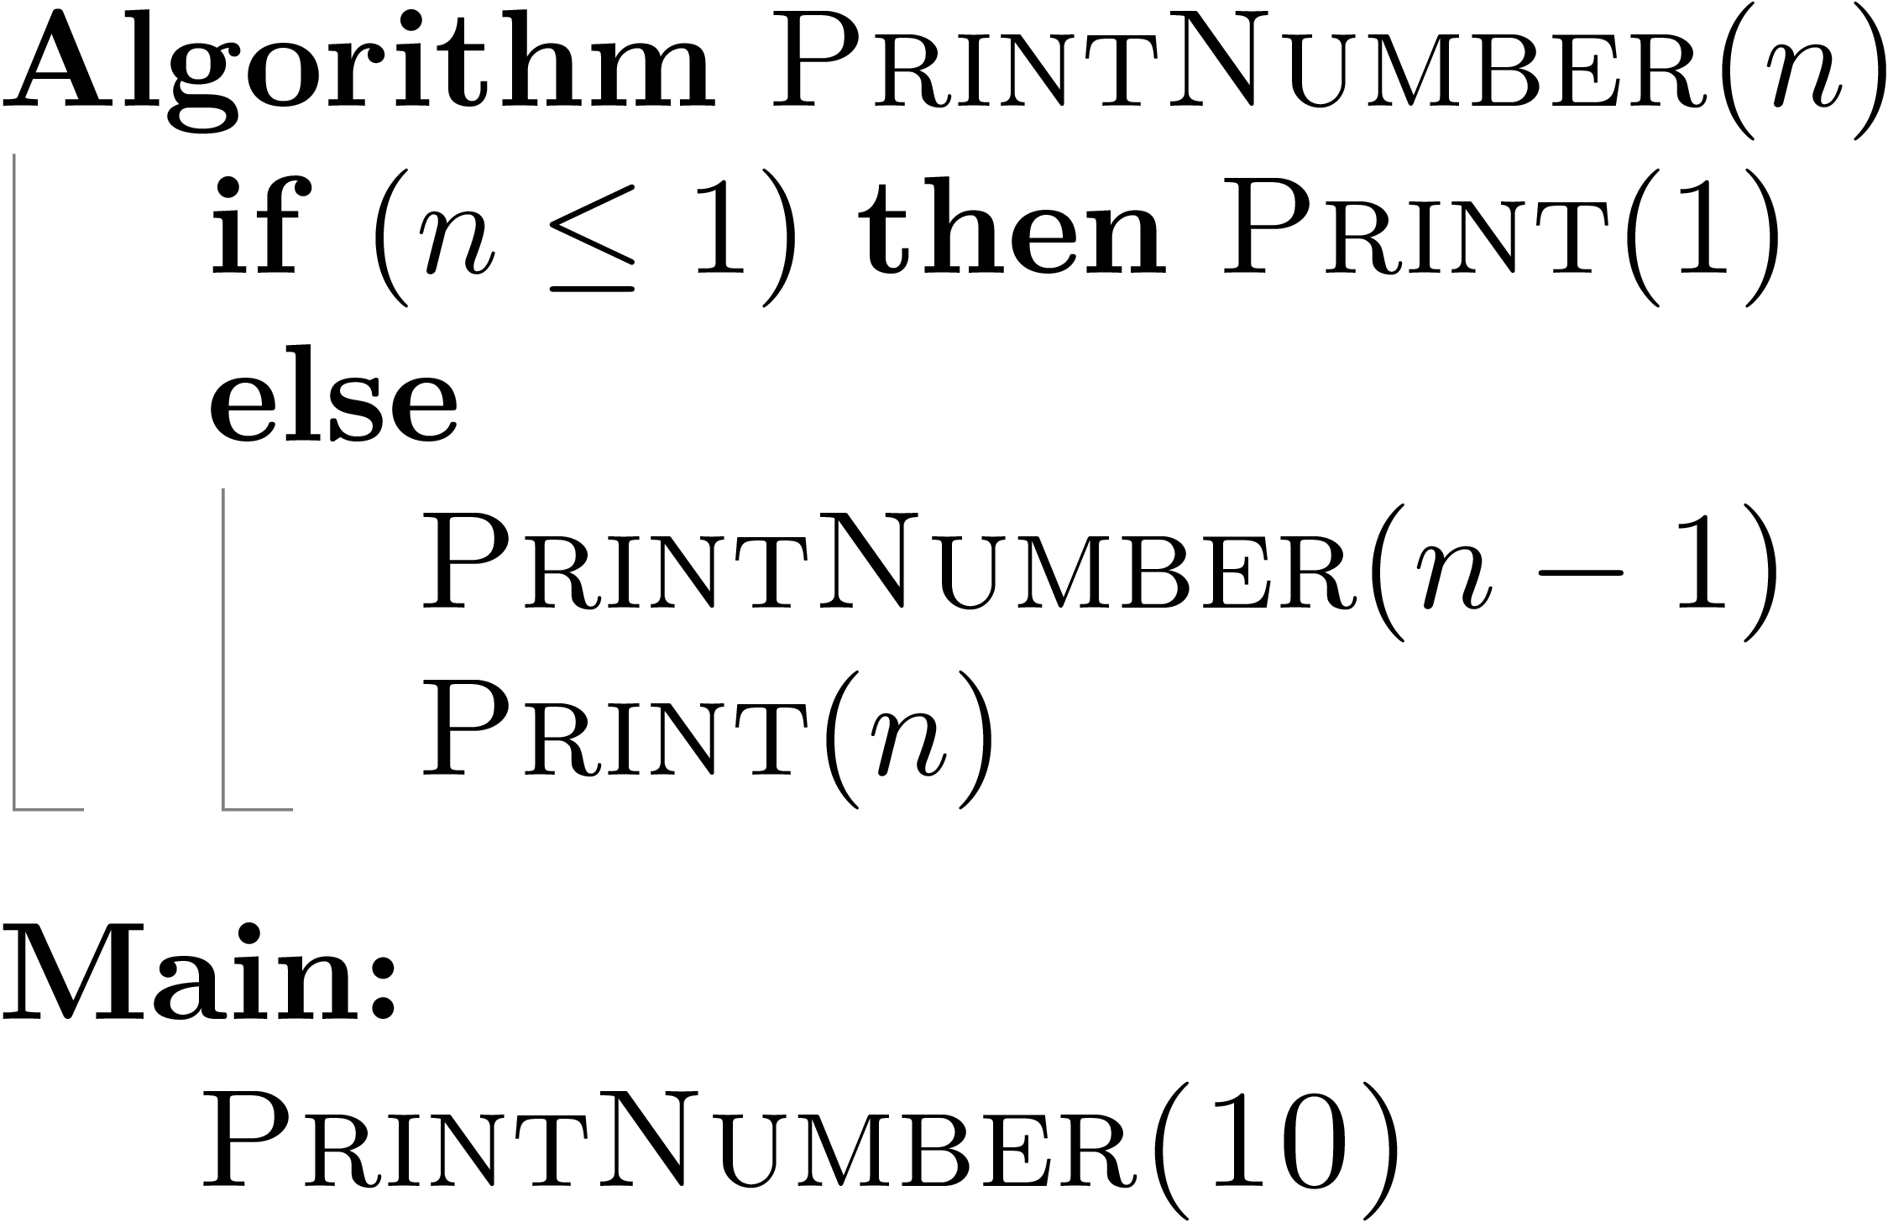
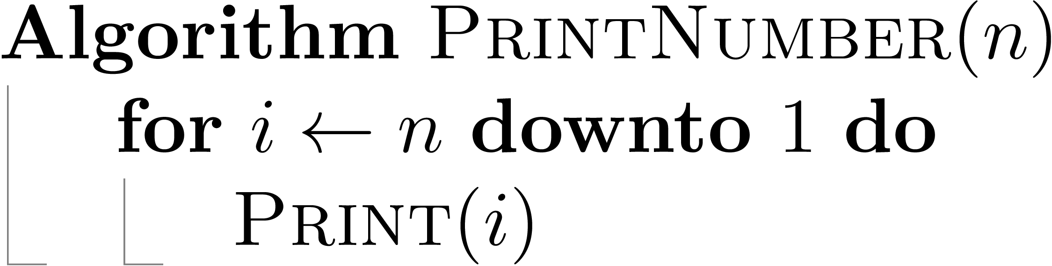
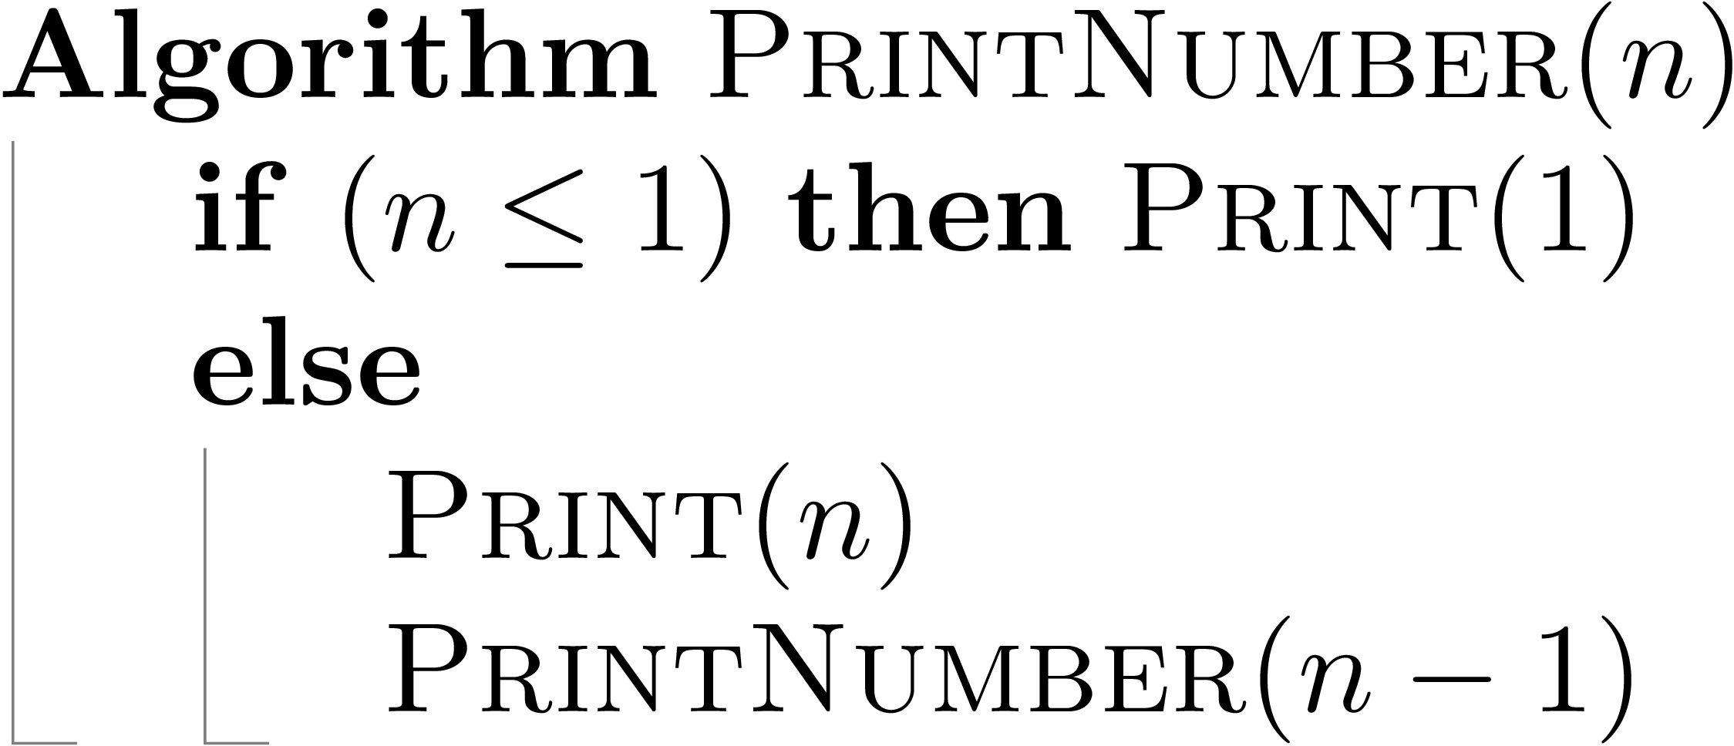

What is an Algorithm? – Example 1
Write an algorithm that prints the numbers from 1 to $n$.
Write the same algorithm but print the numbers from $n$ down to 1.
Solution #1: Using iterative method
Solution #2: Using recursion
Solution #1: Using iterative method
Solution #2: Using recursion

Slide 5

What is an Algorithm? – Example 2
Write an algorithm that computes Greatest Common Divisor (GCD) between two nonnegative, not-both-zero integers $m$ and $n$
Solution #1: Euclidean Algorithm (Euclid of Alexandria – 3rd century B.C.)
For $m≥n$, repeatedly apply the rule $gcd⁡(m, n) = gcd⁡(n, m mod n)$ until $m mod n = 0$. The last value of $m$ is the answer.
gcd | m | n | r = m mod n
gcd(24,18) | 24 | 18 | r = 24 mod 18 = 6
gcd(18,6) | 18 | 6 | r = 18 mod 6 = 0
gcd(6,0) | 6 | 0
Answer : GCD(24,18) = 6

Slide 6
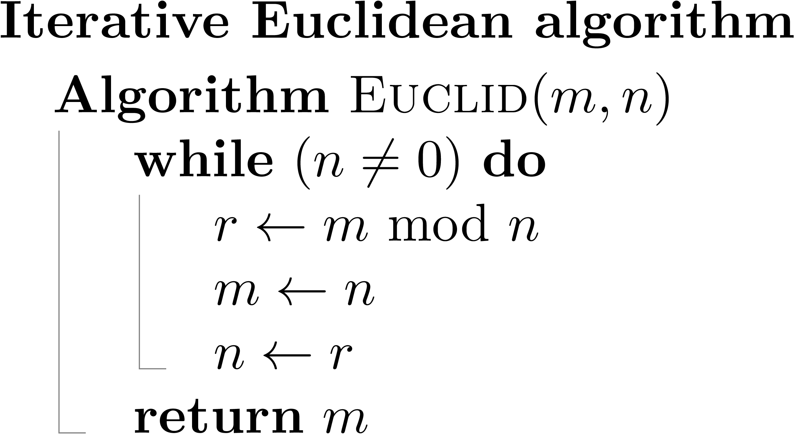
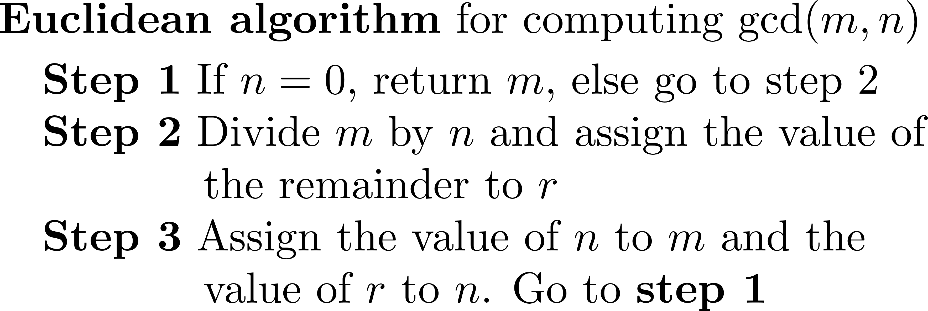
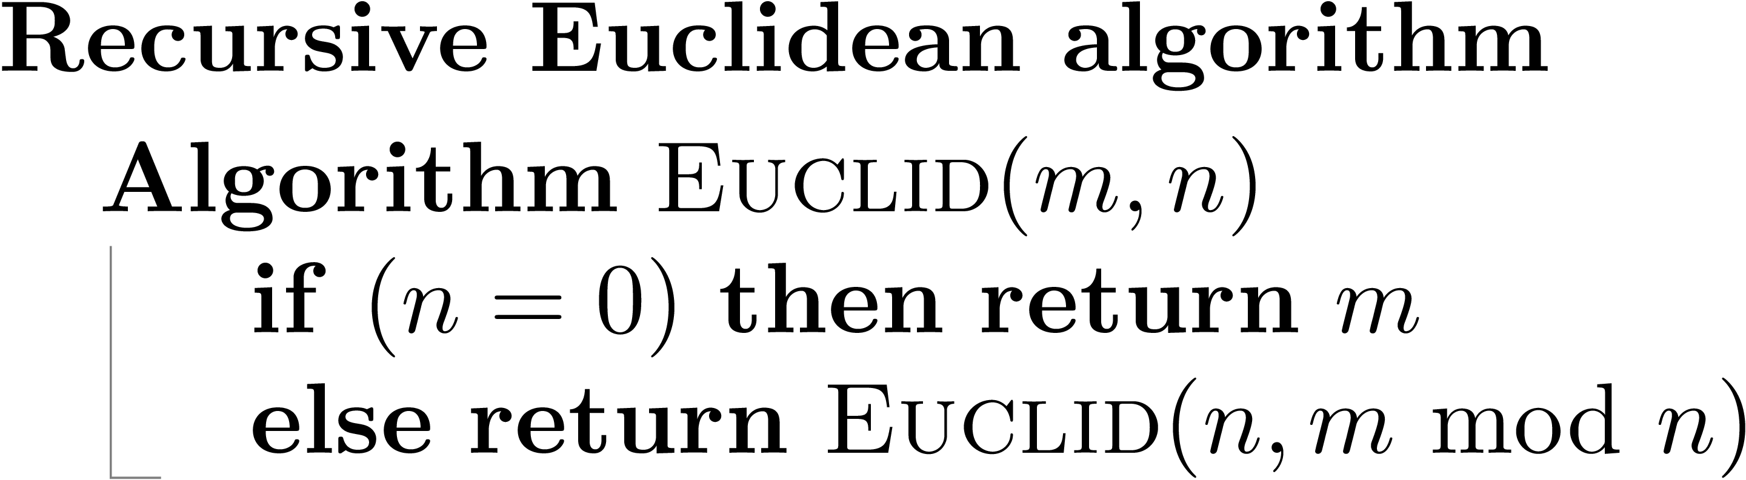

What is an Algorithm? – Example 2
Write an algorithm that computes Greatest Common Divisor (GCD) between two nonnegative, not-both-zero integers $m$ and $s$.
Solution #1: Euclidean Algorithm (Euclid of Alexandria – 3rd century B.C.)
For $m≥n$, repeatedly apply the rule $gcd⁡(m, n) = gcd⁡(n, m mod n)$ until $m mod n = 0$. The last value of $m$ is the answer.

Slide 7
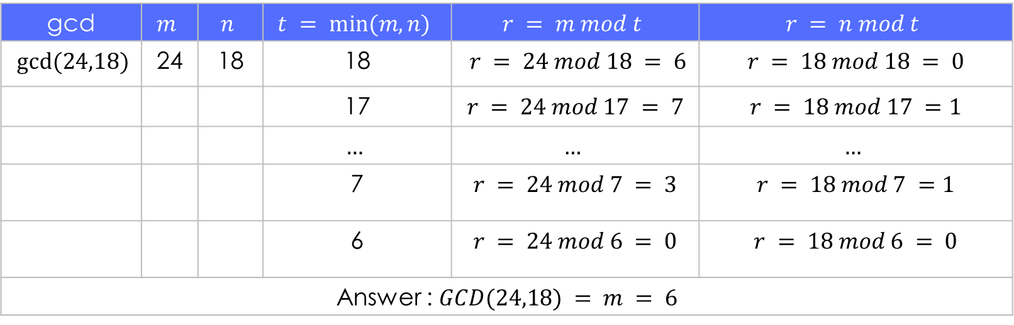

What is an Algorithm? – Example 2
Solution 2: Consecutive Integer Checking Algorithm (CICA).
Find gcd(24,18) Using CICA Algorithm.
gcd | $$m$$ | $$n$$ | $$t = min⁡(m,n)$$ | $$r = m mod t$$ | $$r = n mod t$$
$gcd⁡(24,18)$ | 24 | 18 | 18 | $$r = 24 mod 18 = 6$$ | $$r = 18 mod 18 = 0$$
 |  |  | 17 | $$r = 24 mod 17 = 7$$ | $$r = 18 mod 17 =1$$
 |  |  | $$…$$ | $$…$$ | $$…$$
 |  |  | 7 | $$r = 24 mod 7 = 3$$ | $$r = 18 mod 7 =1$$
 |  |  | 6 | $$r = 24 mod 6 = 0$$ | $$r = 18 mod 6 = 0$$
Answer : $GCD(24,18) = m = 6$

Slide 8
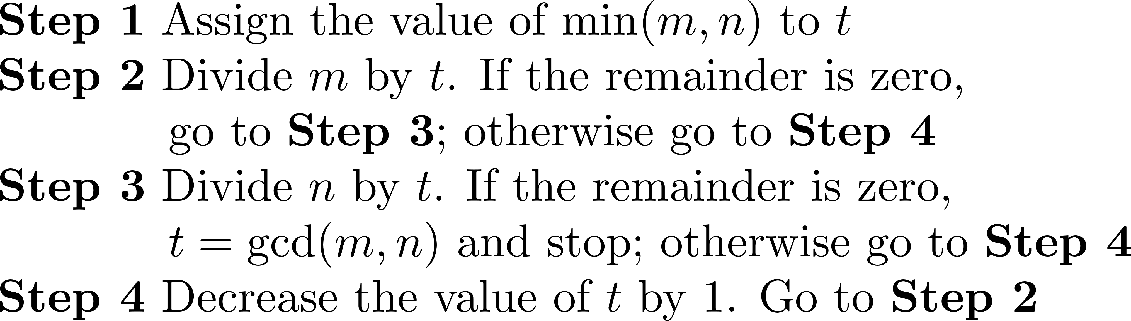
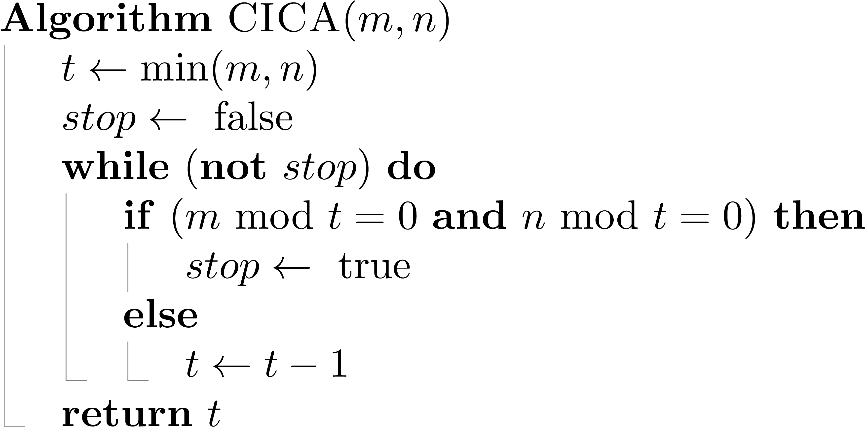
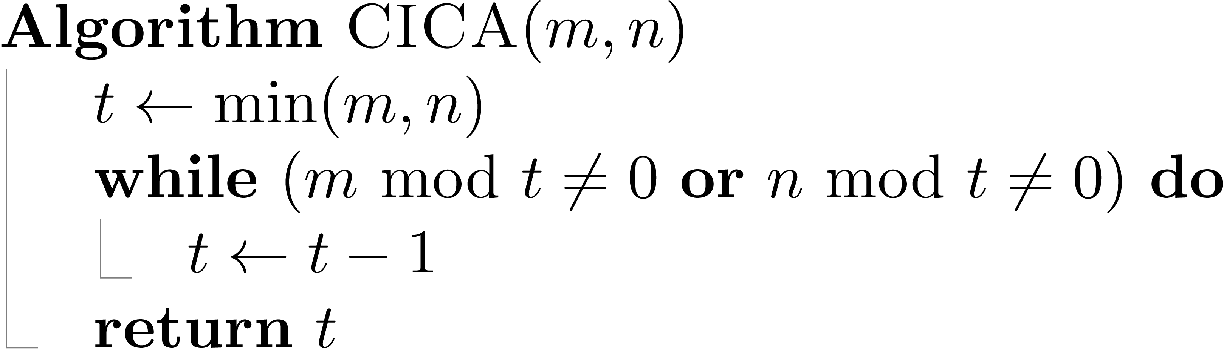
What is an Algorithm? – Example 2
Solution 2: Consecutive Integer Checking Algorithm (CICA).
Pseudocode
Using a Boolean variable stop
Without using the Boolean stop

Slide 9
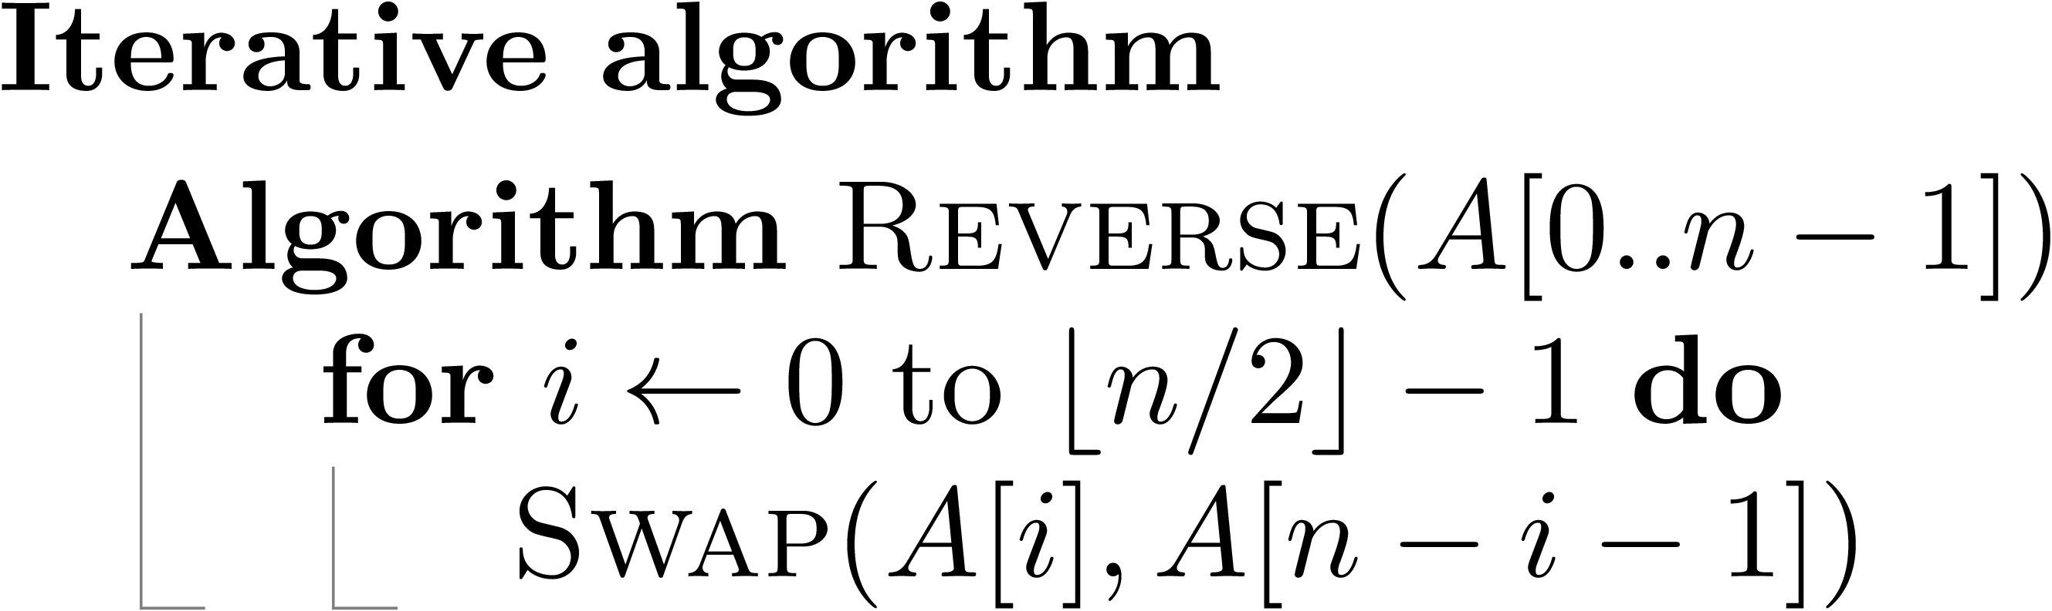
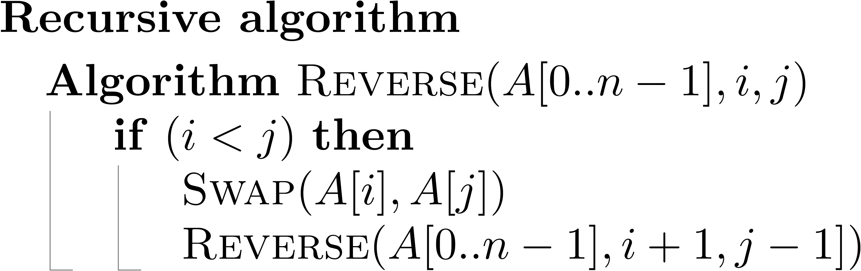
What is an Algorithm? – Example 3
Write an algorithm that reverses the elements of an array A[0..n-1]
0 | 1 | 2 | 3 | 4 | 5 | 6
5 | 3 | 7 | 8 | 1 | 9 | 6
Before A→
0 | 1 | 2 | 3 | 4 | 5 | 6
6 | 9 | 1 | 8 | 7 | 3 | 5
After A→

Slide 10
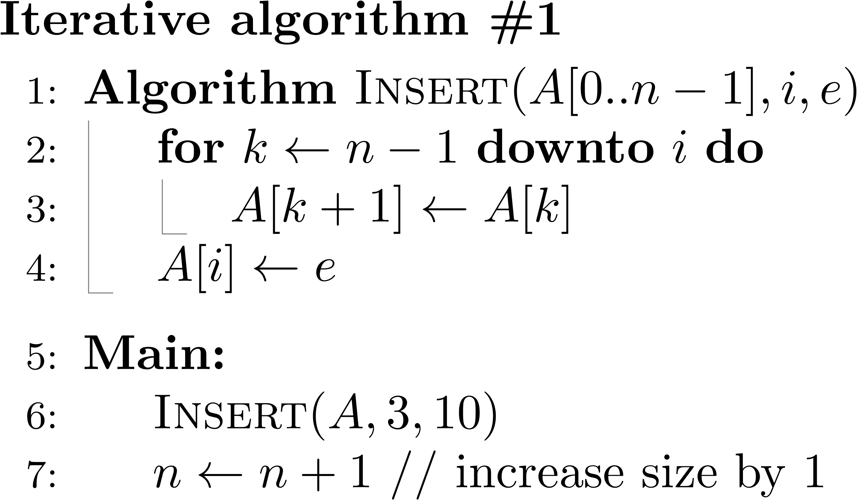




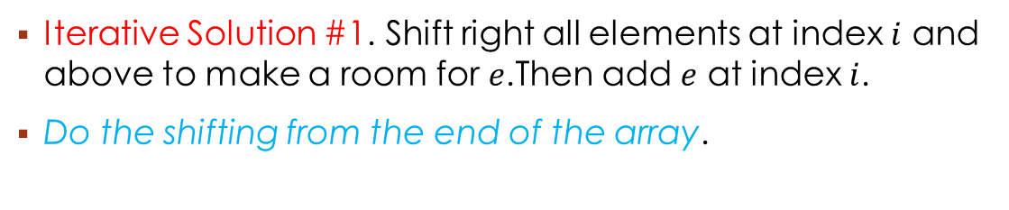



What is an Algorithm? – Example 4
Write an algorithm that inserts an element $e$ in an array $A[0..n−1]$at index $i$
$$i$$
$$e=10$$
0 | 1 | 2 | 3 | 4 | 5 | 6
5 | 3 | 7 | 8 | 1 | 9 | 6
$$n−1$$
A→
Iterative Solution #1. Shift right all elements at index $i$ and above to make a room for $e$.Then add $e$ at index $i$.
Do the shifting from the end of the array.
$$n−1$$
$$n$$
0 | 1 | 2 | 3 | 4 | 5 | 6 | 7
5 | 3 | 7 | 8 | 1 | 9 | 6 | ?
A→
$$k$$
$$k+1$$

Slide 11
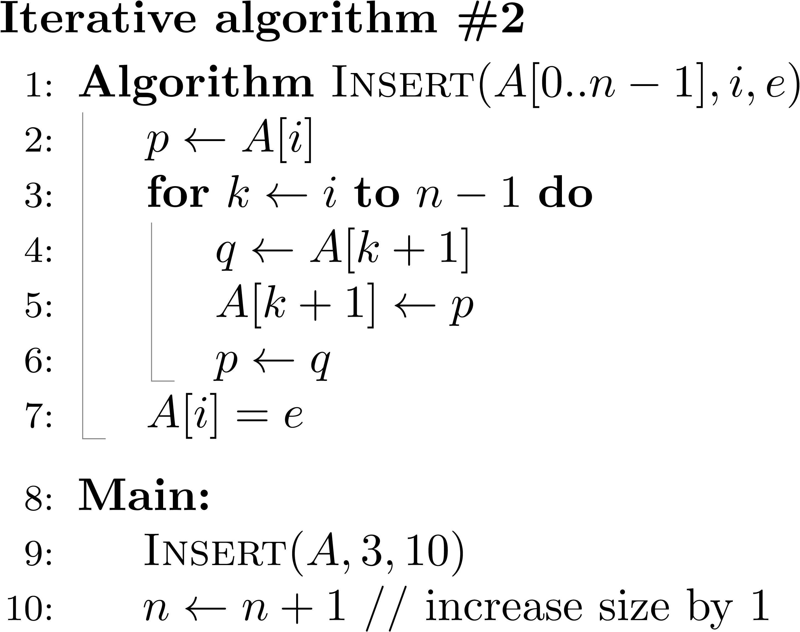






What is an Algorithm? – Example 4
Write an algorithm that inserts an element e in an array A[0..n-1] at index i
$$i$$
$$e=10$$
0 | 1 | 2 | 3 | 4 | 5 | 6
5 | 3 | 7 | 8 | 1 | 9 | 6
$$n−1$$
A→
Iterative Solution #2. Shift right all elements at index i and above to make a room for e. Then add e into index i.
Do the shifting starting from index i.
0 | 1 | 2 | 3 | 4 | 5 | 6 | 7
5 | 3 | 7 | 8 | 1 | 9 | 6 | ?
A→
$$i$$
?
You need to save this element before shifting. Save it into variable q
$$k$$
$$k+1$$

Slide 12
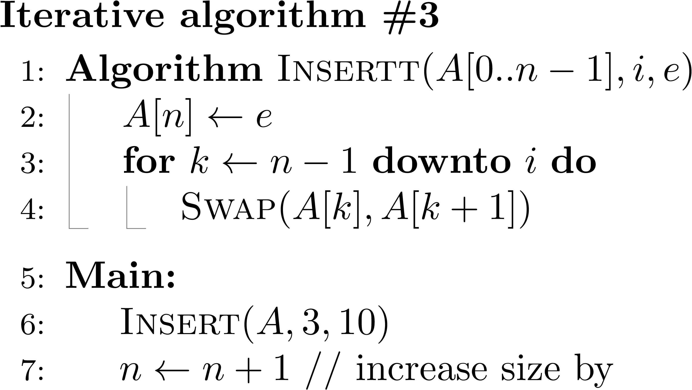

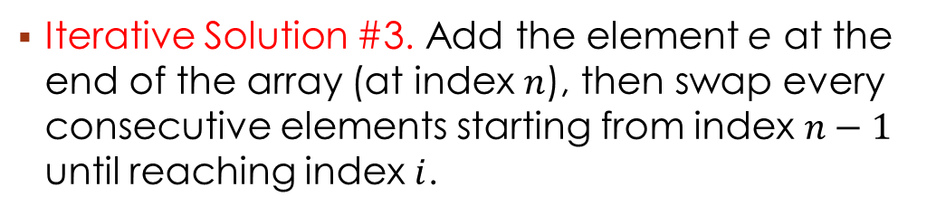




What is an Algorithm? – Example 4
Write an algorithm that inserts an element e in an array A[0..n-1] at index i
i
$$e=10$$
0 | 1 | 2 | 3 | 4 | 5 | 6 | 7
5 | 3 | 7 | 8 | 1 | 9 | 6 | 10
A→
$$n−1$$
swap
$$n$$
Iterative Solution #3. Add the element e at the end of the array (at index $n$), then swap every consecutive elements starting from index $n−1$ until reaching index $i$.
$$n−1$$
e = 10
i
10
0 | 1 | 2 | 3 | 4 | 5 | 6 | 7
5 | 3 | 7
A→
8
1
9
6
?
$$k$$

Slide 13
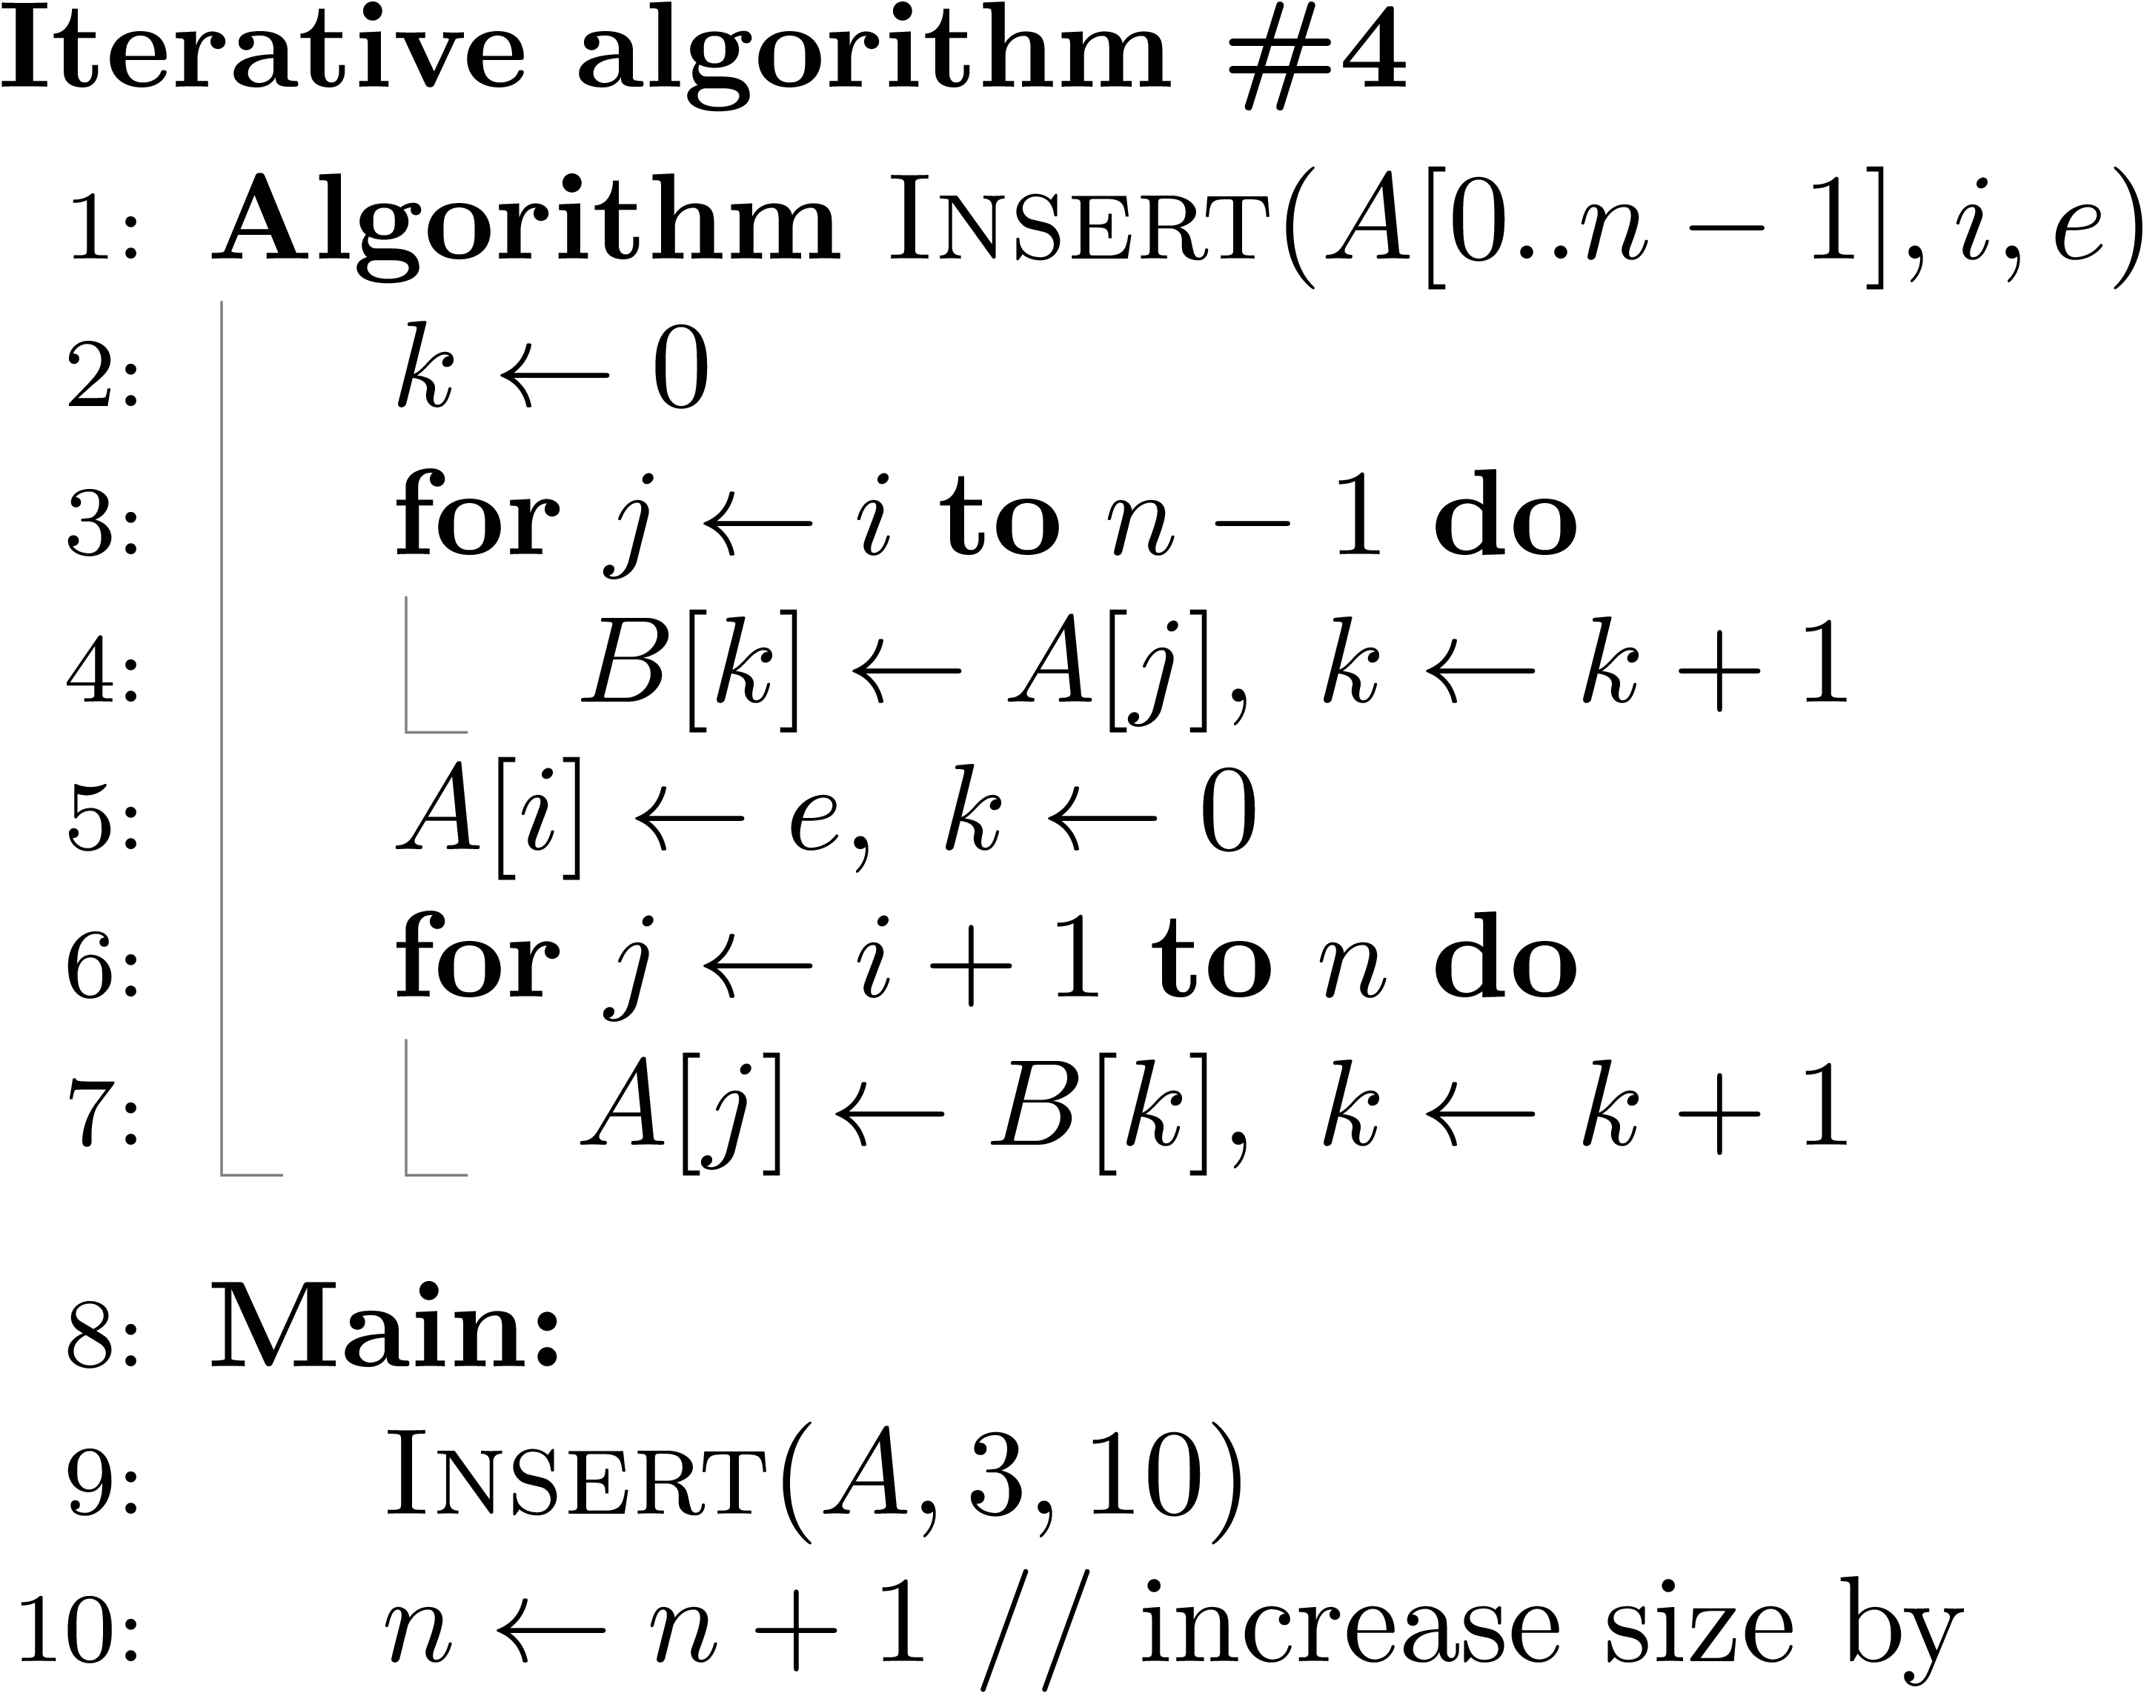




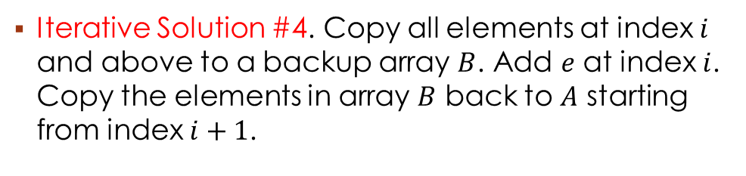



What is an Algorithm? – Example 4
Write an algorithm that inserts an element e in an array A[0..n-1] at index i
$$i$$
$$e=10$$
$$n−1$$
0 | 1 | 2 | 3 | 4 | 5 | 6
5 | 3 | 7 | 8 | 1 | 9 | 6
A→
Iterative Solution #4. Copy all elements at index $i$ and above to a backup array $B$. Add $e$ at index $i$. Copy the elements in array $B$ back to $A$ starting from index $i+1$.
$$i$$
$i$+1
$$n−1$$
$$n$$
0 | 1 | 2 | 3 | 4 | 5 | 6 | 7
5 | 3 | 7 | 8 | 1 | 9 | 6 | ?
A→
0 | 1 | 2 | 3
8 | 1 | 9 | 6
B→

Slide 14
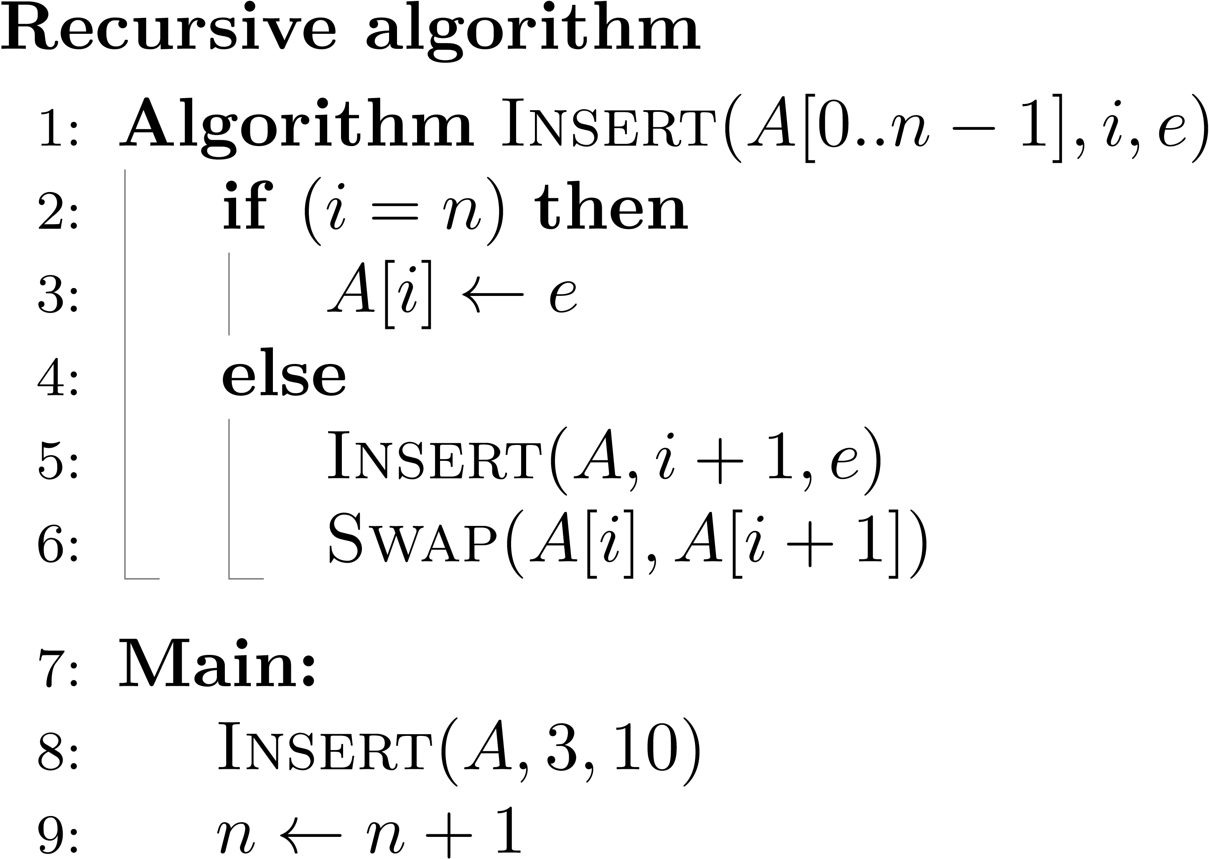








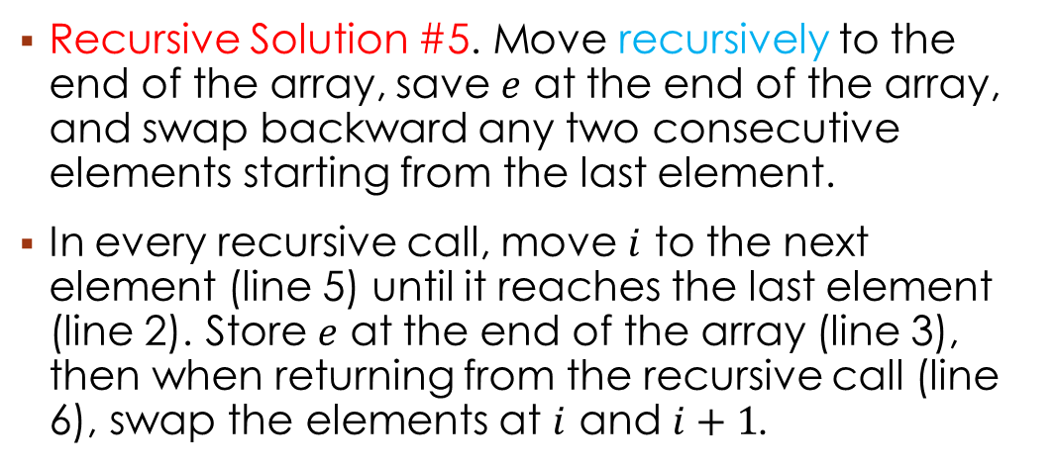

What is an Algorithm? – Example 3
Write an algorithm that inserts an element e in an array A[0..n-1] at index i
$$n−1$$
e = 10
0 | 1 | 2 | 3 | 4 | 5 | 6
5 | 3 | 7
10
A→
8
1
9
6
?
$$n$$
$$i$$
$$i$$
$$i$$
$$i$$
$$i$$
$$i$$
Recursive Solution #5. Move recursively to the end of the array, save $e$ at the end of the array, and swap backward any two consecutive elements starting from the last element.
In every recursive call, move $i$ to the next element (line 5) until it reaches the last element (line 2). Store $e$ at the end of the array (line 3), then when returning from the recursive call (line 6), swap the elements at $i$ and $i+1$.

Slide 15
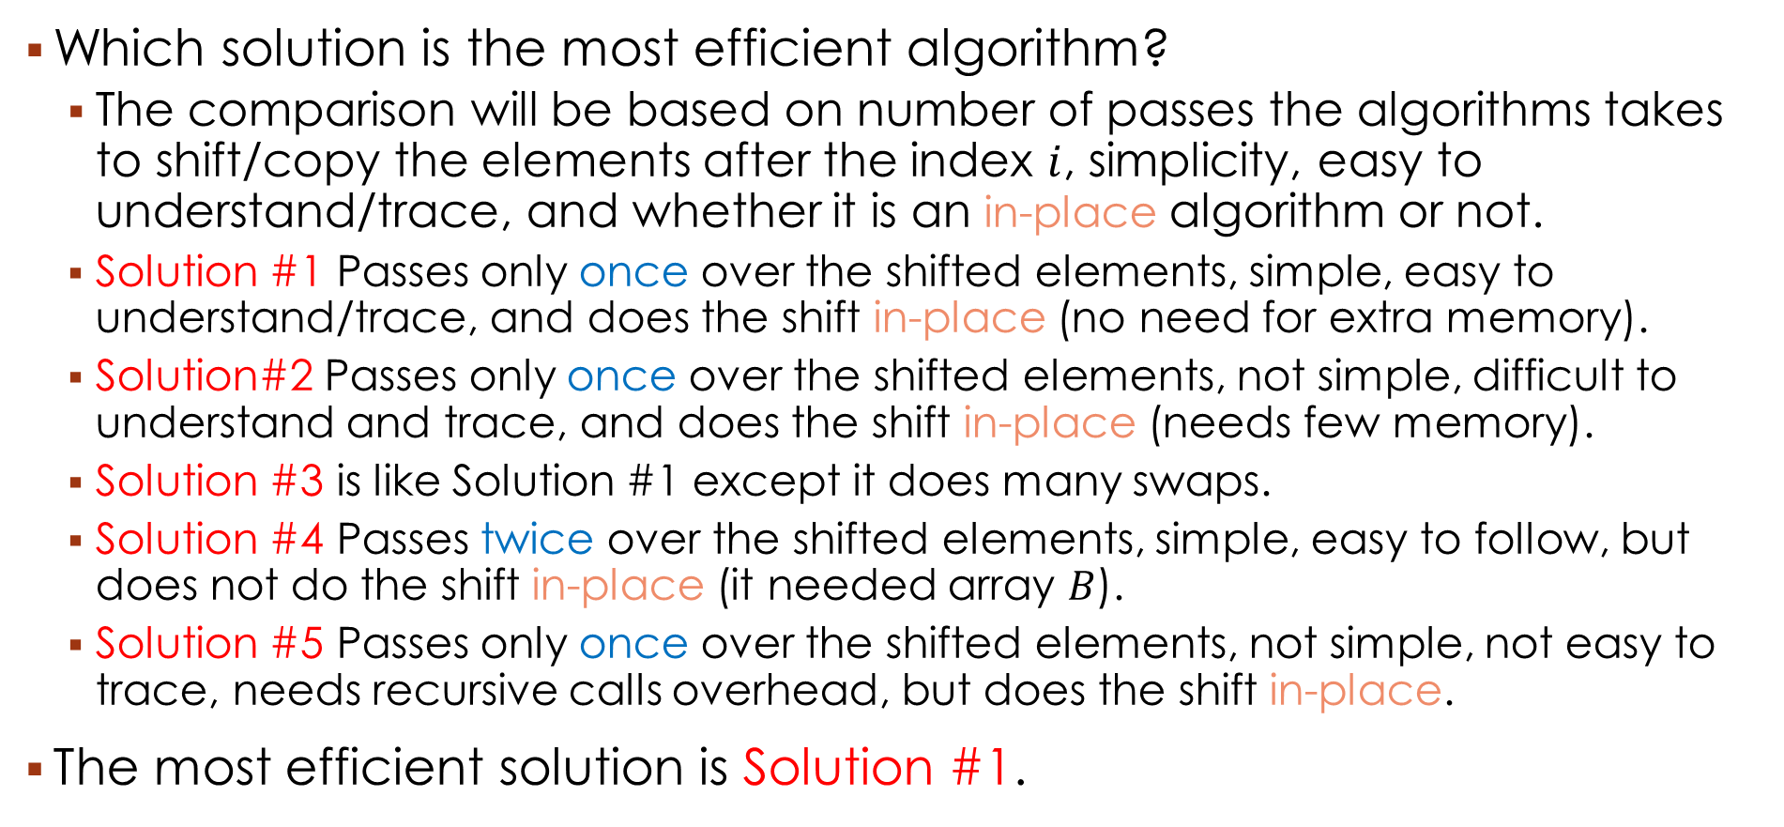
What is an Algorithm? – Example 3
Which solution is the most efficient algorithm?
The comparison will be based on number of passes the algorithms takes to shift/copy the elements after the index $i$, simplicity, easy to understand/trace, and whether it is an in-place algorithm or not.
Solution #1 Passes only once over the shifted elements, simple, easy to understand/trace, and does the shift in-place (no need for extra memory).
Solution#2 Passes only once over the shifted elements, not simple, difficult to understand and trace, and does the shift in-place (needs few memory).
Solution #3 is like Solution #1 except it does many swaps.
Solution #4 Passes twice over the shifted elements, simple, easy to follow, but does not do the shift in-place (it needed array $B$).
Solution #5 Passes only once over the shifted elements, not simple, not easy to trace, needs recursive calls overhead, but does the shift in-place.
The most efficient solution is Solution #1.

Slide 16
2. Fundamentals of Algorithmic Problem Solving
Understand the problem
Algorithm design and analysis process
Decide on: Computational means, exact vs approximate solution, data structure(s), algorithm design technique
Design an algorithm
Prove correctness
Analyze the algorithm
Code the algorithm

Slide 17
2. Fundamentals of Algorithmic Problem Solving
Read the problem description carefully
Solve few small examples by hand
Think about special cases
Compare the problem with existing problems
An input to an algorithm specifies an instance of the problem: Specify the range of instances.
Understand the problem
Decide on: Computational means, exact vs approximate solution, data structure(s), algorithm design technique
Design an algorithm
Prove correctness
Analyze the algorithm
Code the algorithm

Slide 18
2. Fundamentals of Algorithmic Problem Solving
Select the appropriate computing device:
RAM architecture: instructions are executed sequentially.
Parallel architecture or cloud: instructions are executed in parallel.
Worry about the computer speed and its amount of memory.
Exact vs approximate problem solving:
Exact: always produces an exact (optimal) solution (but sometimes very slow)
Approximate: Produces a near-optimal solution in an accepted running time
Select the appropriate Data structures: Algorithms + Data Structures = Programs
Understand the problem
Decide on: Computational means, exact vs approximate solution, data structure(s), algorithm design technique
Design an algorithm
Prove correctness
Analyze the algorithm
Code the algorithm

Slide 19
2. Fundamentals of Algorithmic Problem Solving
Understand the problem
Algorithm design techniques (strategy, paradigm):
General approach to solving problems algorithmically
Examples: brute force , divide and conquer, dynamic programming, etc.
Represent the algorithm in some fashion
In words: in a step-by-step form (Simple but ambiguous)
In pseudocode (for, if, while, ←, //, …)
In flowchart form (connected geometric shapes)
Decide on: Computational means, exact vs approximate solution, data structure(s), algorithm design technique
Design an algorithm
Prove correctness
Analyze the algorithm
Code the algorithm

Slide 20
2. Fundamentals of Algorithmic Problem Solving
Yields a required result for every legitimate input in a finite amount of time.
The correctness of Euclid’s algorithm depends on the correctness of the formula gcd(m, n) = gcd(n, m mod n)
Proof by induction is a common technique
Tracing the algorithm’s performance for specific inputs is not enough to prove the correctness of an algorithm.
However, if an algorithm fails on an instance, it is rejected.
Understand the problem
Decide on: Computational means, exact vs approximate solution, data structure(s), algorithm design technique
Design an algorithm
Prove correctness
Analyze the algorithm
Code the algorithm

Slide 21
2. Fundamentals of Algorithmic Problem Solving
Understand the problem
Efficiency:
Time efficiency: how fast the algorithm runs
Space efficiency: how much extra memory the algorithm needs
Simplicity: Easy to understand, easy to code
Generality: (problem/input)
Quadratic equation algorithm can not solve higher degree polynomials
Decide on: Computational means, exact vs approximate solution, data structure(s), algorithm design technique
Design an algorithm
Prove correctness
Analyze the algorithm
Code the algorithm

Slide 22
2. Fundamentals of Algorithmic Problem Solving
Understand the problem
Special care should be given to the code
Test different input scenarios (identify the exceptions, and the boundaries).
It helps to analyze the algorithm time efficiency.
Decide on: Computational means, exact vs approximate solution, data structure(s), algorithm design technique
Design an algorithm
Prove correctness
As a rule, a good algorithm is a result of repeated effort and rework
Analyze the algorithm
Code the algorithm

Slide 23
3. Important Problem Types - Sorting
Sort the items of a list in nondecreasing order (ascending order).
There must be a relation of total ordering between the items.
Items: numbers, characters, strings, records (school, library, company)
Records need a key to be sorted (id, name, gpa, salary)
Sorting helps in answering many questions about a list.
Searching is easier in sorted dictionaries, class lists, telephone books
Sorting is used in many algorithms to solve some tasks
Dozens of sorting algorithms have been developed.
The best sorting algorithms are fast, in place (do not need extra memory) and stable (sorting a sorted list with another key keeps the list sorted according to the 1st key).

Slide 24
3. Important Problem Types - Sorting
Stable sorting algorithm
None stable sorting algorithm
1st key is name 2nd key is GPA
0 | 1 | 2 | 3 | 4 | 5
3 | 4₁ | 7 | 2 | 1 | 4₂
Before Sorting
A→
Sorted by NAME
Jassim | 3.4
Layla | 3.2
Reham | 3.4
Saad | 3.1
Sorted by GPA Stable
Saad | 3.1
Layla | 3.2
Jassim | 3.4
Reham | 3.4
Sorted by GPA None-Stable
Saad | 3.1
Layla | 3.2
Reham | 3.4
Jassim | 3.4
0 | 1 | 2 | 3 | 4 | 5
1 | 2 | 3 | 4₁ | 4₂ | 7
After Sorting
A→
0 | 1 | 2 | 3 | 4 | 5
3 | 4₁ | 7 | 2 | 1 | 4₂
Before Sorting
A→
0 | 1 | 2 | 3 | 4 | 5
1 | 2 | 3 | 4₂ | 4₁ | 7
After Sorting
A→

Slide 25
3. Important Problem Types - Searching
Search key to be found in a given set.
Sequential (linear search), Binary search (the list must be sorted) etc.
No single algorithm fits all situations best.
Some are fast but require more memory or require sorted list (binary search)

Slide 26
3. Important Problem Types - Searching
Search Key = 1 → is found at index 4 in the list
0 | 1 | 2 | 3 | 4 | 5
3 | 4 | 7 | 2 | 1 | 5
A→
Search Key = 8 → is not found in the list
0 | 1 | 2 | 3 | 4 | 5
3 | 4 | 7 | 2 | 1 | 5
A→

Slide 27
3. Important Problem Types – String processing
Non-numerical data: strings (sequence of characters from an alphabet).
Text strings (letters, numbers, and special characters).
Bit strings (0, 1)
Gene sequences : Alphabet = {A, C, G, T}
String matching: A particular problem searching for a word in a text.
Example. Is the pattern NOT found in the text NOBOD NOTICED HIM ?
String processing algorithms are important for computer science, computer language, and compiling issues.

Slide 28
3. Important Problem Types – Graph problems
A graph is a collection of points (vertices or nodes) connected with line segments (edges).
Graphs are used to model real-life applications: transportation, communication networks, project scheduling, games, etc.
Graph algorithms: graph traversal, shortest path, Traveling Salesman Problem (TSP), graph-coloring problem (event scheduling).

Slide 29
3. Important Problem Types – Combinatorial problems
Combinatorial object: permutation, combination or subset that satisfy certain constraints and have objectives (min, max).
TSP and graph coloring are examples of combinatorial problems.
They are the most difficult problems: no algorithm is yet developed to solve them.
Exception: the shortest path problem was solved by an efficient algorithm.

Slide 30
3. Important Problem Types – Geometric problems
Deal with points, lines, and polygons to:
Construct simple geometric shapes – triangles, circles without compass or ruler (Ancient Greeks).
Develop applications for computer graphics, robotics and tomography (radiologic technique for obtaining clear X-ray images ).
The closest pair problem: find the closest pair among n points in the plane.
The convex-hull problem: find the smallest convex polygon including all the points of a given set.

Slide 31
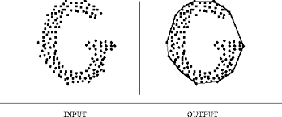
3. Important Problem Types – Geometric problems
The convex-hull problem

Slide 32
3. Important Problem Types – Numerical problems
Numerical problems are those involving mathematical objects of continues nature.
Solving equations, systems of equations, compute definite integrals, evaluate functions.
The majority of these problems can be solved only approximately.
Frequently, the manipulated numbers are real (represented approximately in computers.)
Business applications require algorithms for information storage, retrieval, transportation through networks, and presentation to users.

Slide 33
4. (Optional) Fundamental Data Structures – Linear DS
Arrays and linked lists are types of lists containing data of same type.
Arrays:
The data is accessible by indices (0, 1,...,n-1).
The elements have same access time and occupy same amount of memory.
Arrays are used to implement strings (alphabet characters or binary).
Linked lists:
Contain nodes (information + link(s)).
Types: singly, doubly, circular
The access to a node requires the access to all its predecessors.
Item[0]
Item[1]
…
Item[n-1]
Array of n elements
Item 0
Item 1
…
Item n-1
null
Singly linked list of n elements

Slide 34
4. Fundamental Data Structures – Linear DS
Two special types of lists:
Stack (LIFO): list where the insertion (push) and deletion (pop) are done only at the end (top).
Stacks are indispensable for implementing recursive algorithms.
Queue (FIFO): Elements are inserted (enqueue) from one end (front) and deleted (dequeued) from the other hand (rear).
Queues are used in many algorithms for graph problems.
Priority queues: deletion is performed based on a priority (emergency in hospitals).

Slide 35
4. Fundamental Data Structures – Graphs
Formally a graph G is defined as: G = (V, E)
Graph keywords: vertex, node, edge, arc, adjacent, directed, undirected, head, tail, incident, digraph, complete, path, cycle, connected.
A graph is represented by and adjacency matrix (0s and 1s indicating the inclusion or exclusion of edges) or an adjacency list (collection of linked lists, one for each vertex).
Weighted graph: weights on edges or vertices (Shortest path, TSP).

Slide 36
4. Fundamental Data Structures – Graphs
a
c
b
d
e
f
a b c d e f
a
c
d
a
b
c
d
e
f
0 0 1 1 0 0
0 0 1 0 0 1
1 1 0 0 1 0
1 0 0 0 1 0
0 0 1 1 0 1
0 1 0 0 1 0
b
c
f
c
a
b
e
d
a
e
e
c
d
f
f
b
e
Adjacency matrix
Adjacency list

Slide 37
4. Fundamental Data Structures – Graphs
5
a
b
1
7
4
c
d
2
a b c d
a
b, 5
c, 1
a
b
c
d
∞ 5 1 ∞
5 ∞ 7 4
1 7 ∞ 2
∞ 4 2 ∞
b
a, 5
c, 7
d, 4
c
a, 1
b, 7
d, 2
d
b, 4
c, 5
Weight matrix
Adjacency list

Slide 38
4. Fundamental Data Structures – Trees
Connected acyclic graph.
|E| = |V| - 1
Trees are used to describe hierarchies and analyze the recursive algorithms.
Trees are used in two important algorithm design techniques: backtracking and branch-and-bound.
Free tree vs rooted tree.
A tree
Not a tree
a
c
b
a
c
d
e
f
d
e
i
d
a
c
b
a
e
b
d
e
Rooted tree
c
g
f
h
g
f
h
i
Free tree

Slide 39
4. Fundamental Data Structures – Trees
Tree keywords: ancestor, child, parent, subtree, depth (vertex), height (tree), simple path, leaf.
Ordered tree: rooted tree where the children of each vertex are ordered (left-to-right).
Binary tree: an ordered tree where every vertex has maximum two children.
9
The number assigned to each node is greater than all numbers in its left-subtree and smaller than all numbers in its right-subtree.
Binary search tree
5
12
1
7
10
4

Slide 40
4. Fundamental Data Structures – Sets
A set = unordered collection of distinct elements.
Main operations: search, union, intersection
Represented explicitly (S = {2, 3, 5, 7}) or implicitly (S = {n: n is prime and n < 10}).
Implementation 1 (fast but needs lots of memory): Every set is a subset of the universal set U of size n.
Example: U = {1,2, 3, 4, 5, 6, 7, 8, 9}), S = {2, 3, 5, 7}) → S: 011010100
Implementation 2 (Common): list structure
Sets differ from lists by:
Having distinct elements
The elements are unordered

Slide 41
4. Fundamental Data Structures – Dictionaries
A dictionary is a set that implements three operations:
Search
Insertion
Deletion
The insertion and deletion makes the list dynamic.
~ End of chapter ~

